Slide 1

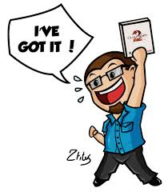

How to find all the user in database ?
What is “auth” in config file ?

Slide 2
MongoDB Administration

Slide 3
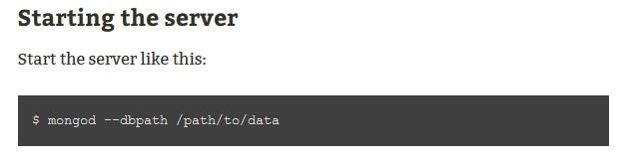
Starting the server

Slide 4
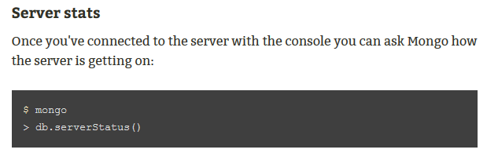
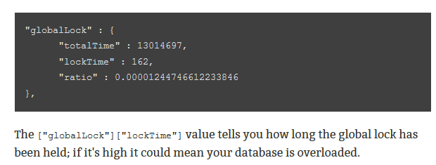
Checking Mongo's status

Slide 5
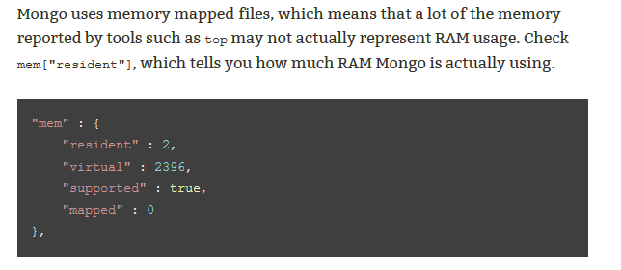
Checking Mongo's status

Slide 6
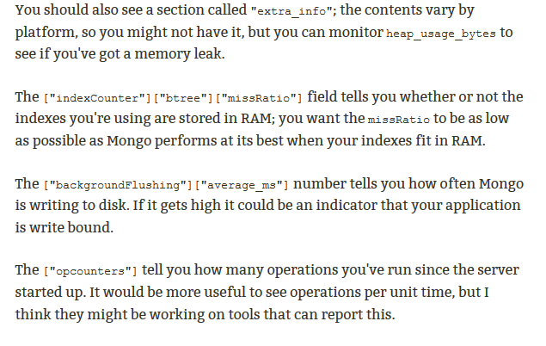
Checking Mongo's status

Slide 7
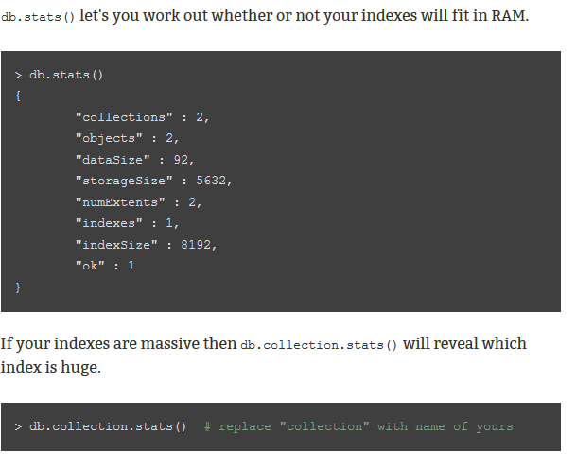
Database and collection stats

Slide 8
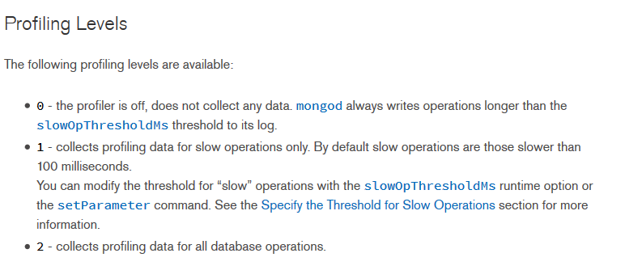
Analyze Performance of Database Operations
Database Profiler Output:-

Slide 9
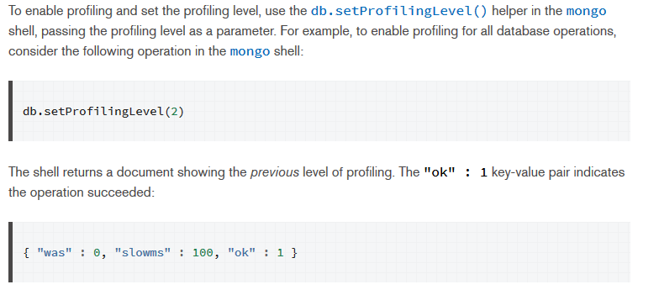
Analyze Performance of Database Operations
Enable Database Profiling and Set the Profiling Level:-

Slide 10
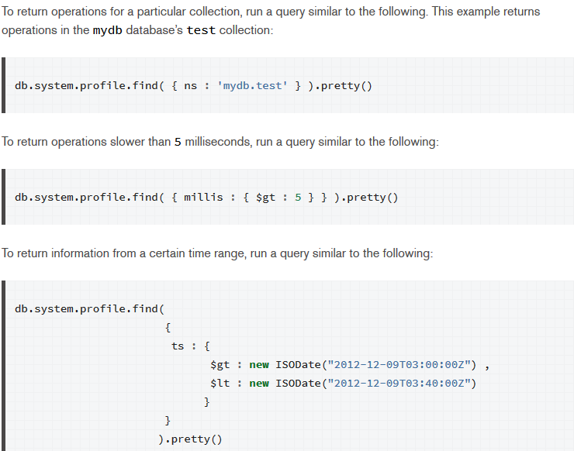
Example Profiler Data Queries

Slide 11
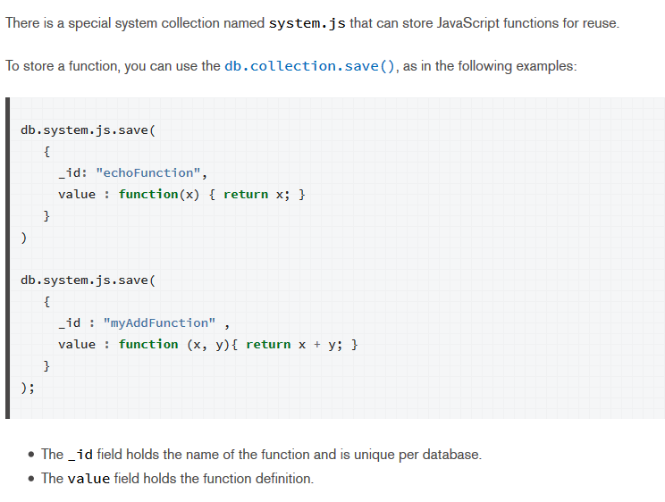
Store a JavaScript Function on the Server

Slide 12
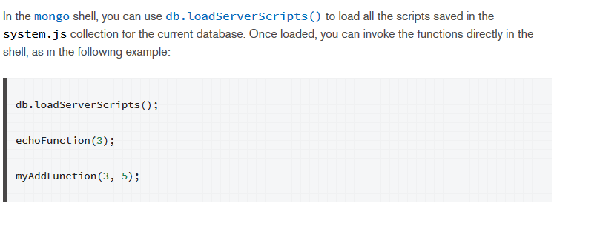
Execute JavaScript Function on the Server

Slide 13
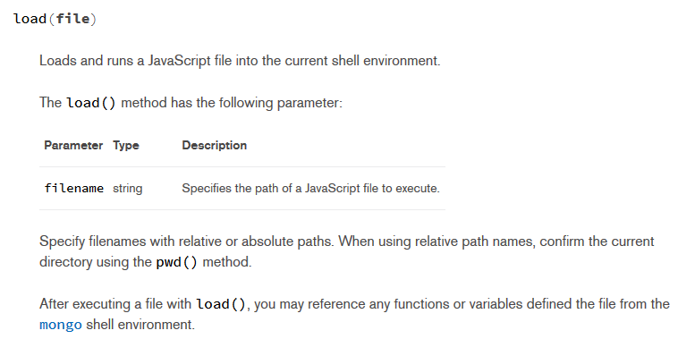
Execute External JavaScripts on the Server

Slide 14

How to identify which user is running which query?
How to delete the profiler collection ?

Slide 15
Thank you for your attention!

